Slide 1


Slide 2


Slide 3


Slide 4


Slide 5

Notes:
Image source: https://divyagodayal.github.io/2018/07/04/A-twisted-tale-of-Binary-Search-49f5ac01e83d/

Slide 6


Slide 7
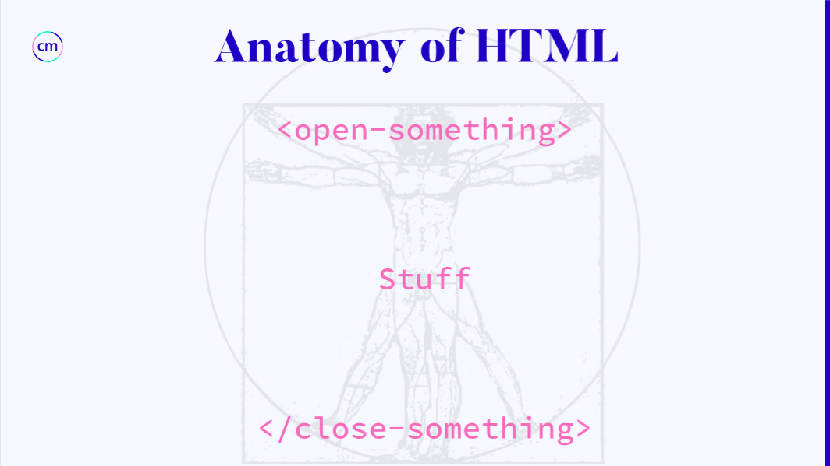

Slide 8


Slide 9

Notes:
src: https://i.pinimg.com/originals/fa/3d/30/fa3d30b23579b132f39999f093d3f7c7.jpg

Slide 10

Notes:
Image source: https://kahanelaw.com/wp-content/uploads/2018/06/DIRECTIONS.jpg

Slide 11


Slide 12


Slide 13


Slide 14
